Slide 1


Slide 2
What are we trying to do?
Keeping a tab on our day to day tasks could be a time consuming task in itself.
The central idea behind this web application is to automate this task. The user can efficiently manage his day to day tasks with just a click.

Slide 3
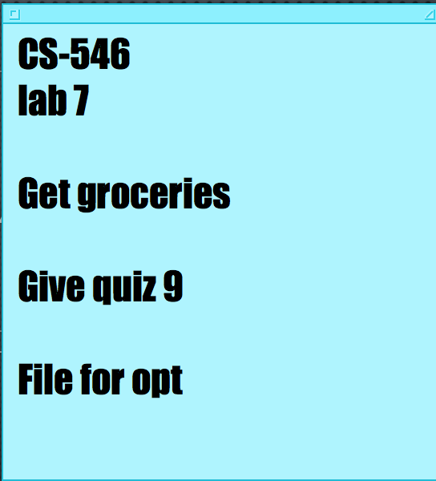
Current solution available
Currently, we can either manually keep a tab on our tasks, remember them in our head or rely on stuff like sticky notes.

Slide 4
What are we bringing to the table
With kanban, you can easily track and manage all of your tasks.
This way, you’ll never forget something important that you had to do and gotten into trouble.
Just log your tasks, enter their status, due date and priority and we’ll take care of the rest.

Slide 5
Who will use kanban?
Students
Teachers
Parents
Everyone!!!

Slide 6
How it works?

Slide 7
lists

Slide 8
tasks
Notes:
Direct monetization simply means that you directly monetize your blog. You profit directly from your blog. In most cases this means you either:
* Sell products on your blog – for example, socks or supplements.
* Sell information products on your blog – for example ebooks or online courses
* Sell services on your blog – for example, copywriting services
* Sell space for companies to advertise – the more traffic you have the more you can charge to place an ad on your blog.
* Place pay per click ads on your website and earn money each time someone clicks on an advertisement.
* Host a membership site on your blog and profit from selling memberships.

Slide 9
How will this project bring in money?
Advertisements
Donations from users
Direct monetization

Slide 10
Future scope
Use cloud services to backup the user tasks.
Users can invite their friends to use this app by sending e-mail invites.
Let the user form groups with other users. This way they can have a group with the same set of tasks, with each task assigned to a user that belongs to the group.

